Slide 1

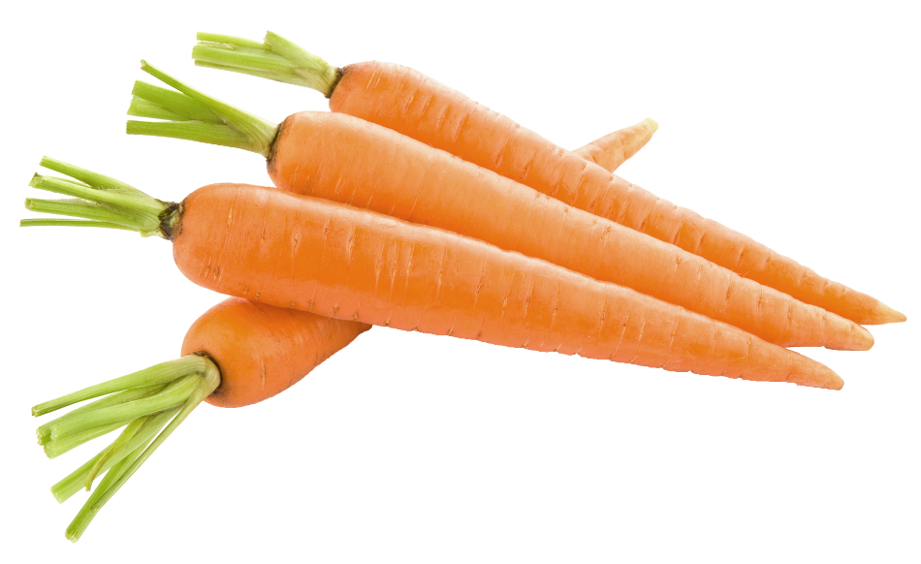


Algebra Revision

Slide 2

Can you remember these?
and =
2a + 3a =

Slide 3
Can you remember these?
and =
2a + 3b =

Slide 4
Can you remember these?
and =
2a + 4c =

Slide 5
Activity
and =
2a + a² =

Slide 6
24
7
30
Date
Like Terms
EQ – How do we simplify algebraic expressions?
What are ‘like terms’?
LIKE TERMS are terms that have exactly the same pronumerals
2a and 5a is an example of LIKE TERMS.
2a and 3b are NOT LIKE TERMS.
4ab and 7ba is an example of LIKE TERMS.
2a and a² are NOT LIKE TERMS.
8a and 8 are NOT LIKE TERMS.
Can we add ‘like terms’?
Like terms CAN be added to get a simpler answer
2a + 3a = 5a
2a + 3b = 2a + 3b NO CHANGE!!!
4ab + 7ba = 11ab
2a + a² + 8a + 8 = a² + 10a + 8
Is subtracting like terms the same?
Yes but we must check the sign in front of the term
12a – 5a + 2a – a = 8a
10a + 5b – 6a – 8b = 4a – 3b

Slide 7


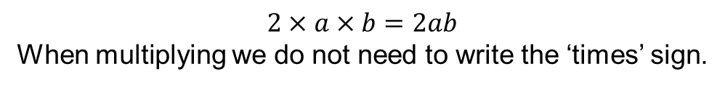




24
7
30
Date
Simplifying Expressions
EQ – How do I simplify if the terms are multiplied?
What happens to the x sign?
$$2×a×b=2ab$$
When multiplying we do not need to write the ‘times’ sign.
Remember: The Distributive law
Multiplication can be done in any order and the answer will be the same.
Examples:
$$3xy ×4m$$
(This means $3×x×y×4×m$)
Multiply the numbers first and then put the letters together.
$$3×4×x×y×m$$
$=12xym$
Something harder: $4x×3z×2xyz$
$$4×3×2×x×x×y×z×z$$
$$4x3x2=24$$
$$x×x=x^{2}$$
Only 1 $y$
$$z×z=z^{2}$$
$$=24x^{2}yz^{2}$$

Slide 8




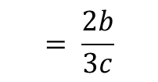






24
7
30
Date
Simplifying Expressions
EQ – How do I simplify if the terms are divided?
$$k÷\text{4}$$
When dividing we use a fraction line instead of $÷$
What happens to the $÷$ sign?
Thus: $= \frac{k}{4}$
1
Examples:
$$÷2$$
$$÷n$$
Divide by 2
$$\frac{2kn}{4n}$$
Cancel out
$$÷2$$
$$÷n$$
2
$$= \frac{k}{2}$$
$$k means 1k$$
We don’t need to write the 1
2
$$÷5$$
$$\frac{10ab}{15ac}$$
$$÷a$$
Cancel out
Divide by 5
$$÷5$$
$$÷a$$
3
$$= \frac{2b}{3c}$$

Slide 9
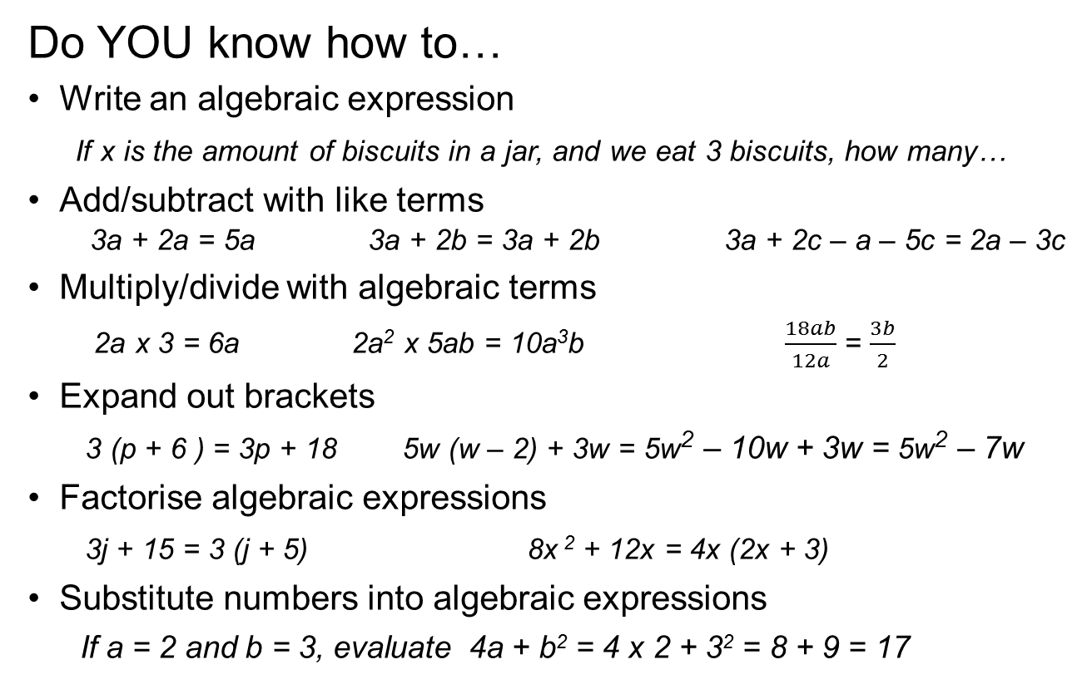
Algebra Review
Do YOU know how to…
Write an algebraic expression
If x is the amount of biscuits in a jar, and we eat 3 biscuits, how many…
Add/subtract with like terms
3a + 2a = 5a 3a + 2b = 3a + 2b 3a + 2c – a – 5c = 2a – 3c
Multiply/divide with algebraic terms
2a x 3 = 6a 2a² x 5ab = 10a³b $\frac{18ab}{12a}$ = $\frac{3b}{2}$
Expand out brackets
3 (p + 6 ) = 3p + 18 5w (w – 2) + 3w = 5w² – 10w + 3w = 5w² – 7w
Factorise algebraic expressions
3j + 15 = 3 (j + 5) 8x ² + 12x = 4x (2x + 3)
Substitute numbers into algebraic expressions
If a = 2 and b = 3, evaluate 4a + b² = 4 x 2 + 3² = 8 + 9 = 17

Slide 10
Don’t forget what these words mean!
Expression
Term
Coefficient
Constant
Pronumeral
Like Terms
Expand
Factorise
Evaluate
Simplify
3a + a + 4ab – 5ba + 3a² + 7

